Slide 1
Cloud-Based AI Battery Characterization tool for Lithium Batteries
Cole Fuerth and Mathew Pellarin
B.A.S.c Computer Science,
O.C.A.D Electronics Engineering Technology
Dr. Bala Balasingam and the BMSLabs Team
March 2023

Slide 2
Underlying Concepts
Batteries
State of Charge
OCV Curves
K-Parameters
Characterization

Slide 3
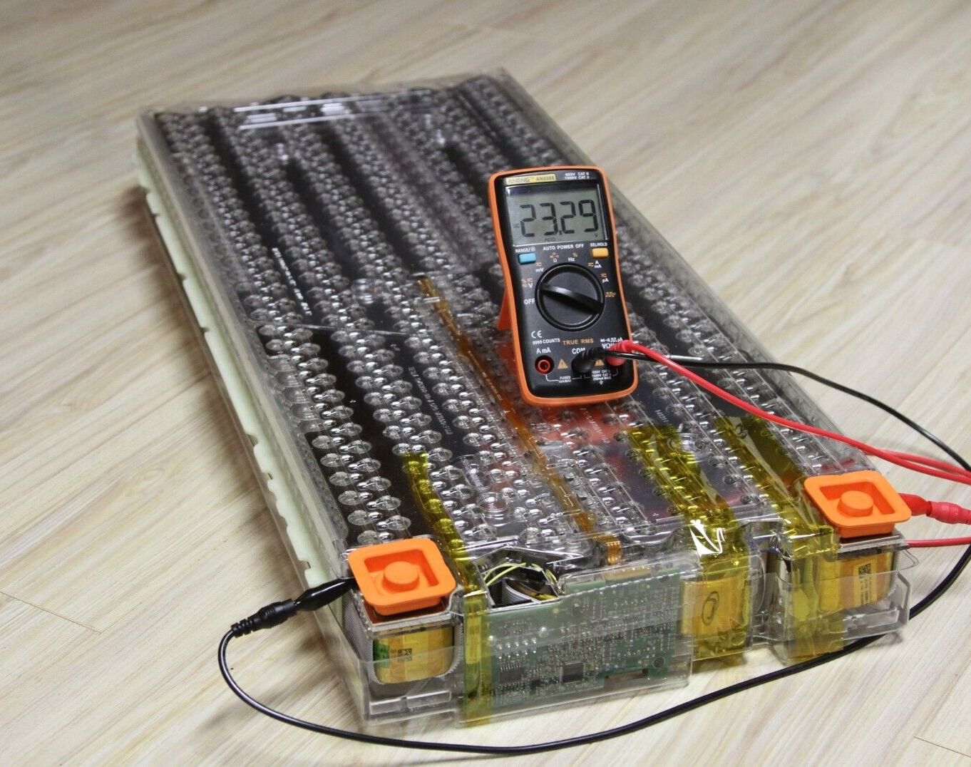
Why Care About Batteries?
Accurate estimation of:
battery capacity
wear
characteristics
EV range heavily relies on accurate estimation, which requires a characterized battery.
Small-scale devices currently do not have a way to store variable OCV curves.
Pack recycling is possible in sections, if there is a way to detect dead cells actively within a pack.

Slide 4
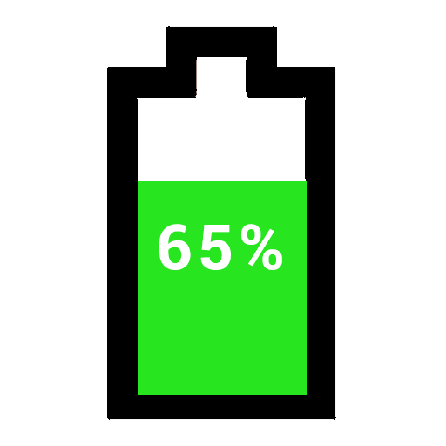
State of Charge
The State-of-Charge (SoC) of a battery is, in essence, its “percent”, in general terms.
This is represented as a floating point, 0 to 1.

Slide 5
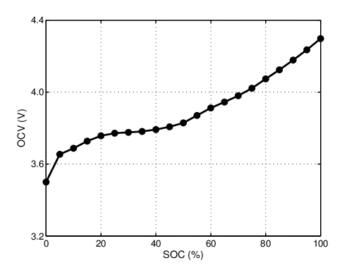
OCV Curves
Open Circuit Curve (OCV)
The change in voltage of a cell across a complete cycle (charge or discharge).
“Open” referring to the voltage (y-axis) that a cell would settle at, at a certain State of Charge (SoC) (x-axis).

Slide 6
K-Parameters
The OCV curve can be parameterized by the below polynomial, coined as the “Combined +3” model.
This is the model most commonly used by the BMSLab team, and so, it is the one of concern for this problem.
The formula allows for an accurate representation of a complete OCV curve, from only 8 floating point coefficients.

Slide 7
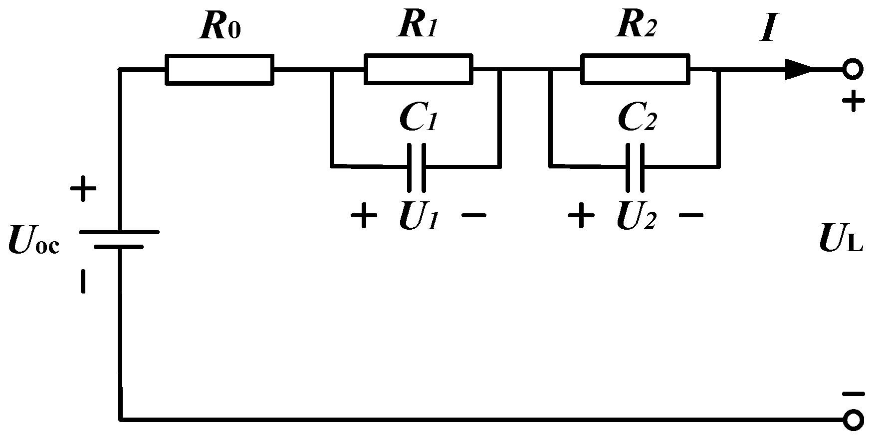
Characterization
Characterization uses least squares fitting.
Even with well-written, hard-coded methods, this method can only be so accurate on field data;
Using more complicated battery models also includes the requirement of more complicated characterizations, which are even more complex using field data.

Slide 8
Artificial Intelligence
Neural Networks
Dataset Curation
Preprocessing the Data
Training the AI
Models Evaluated

Slide 9
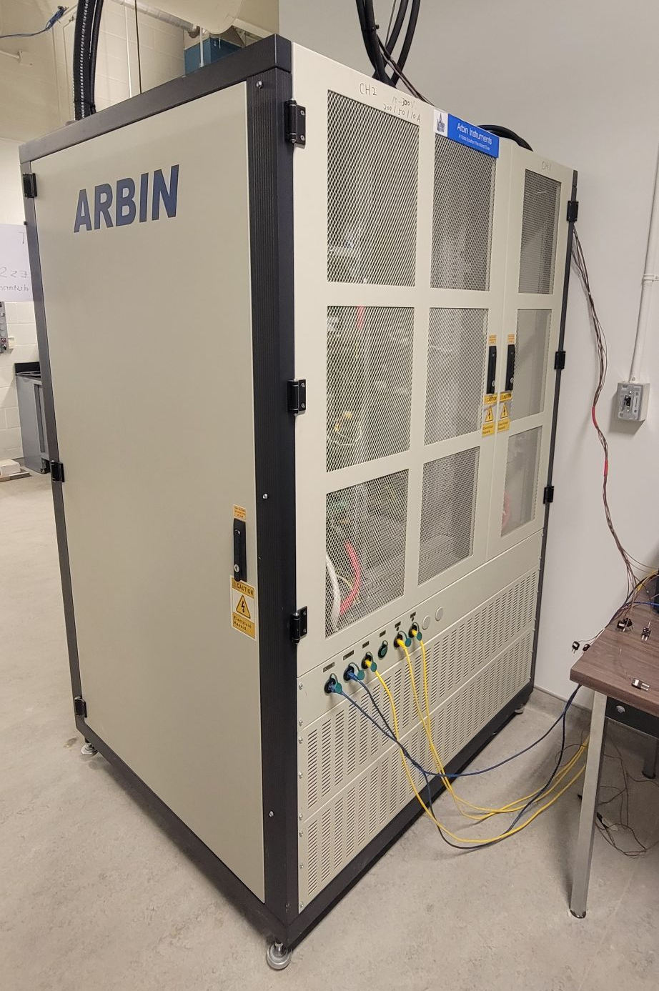
Why a Neural Network?
Currently
Characterization takes over 60+ hours
Usually not worth characterizing old/used cells
With Neural Network
Characterization can be done during usage
Can estimate SOC with more accuracy
Reduce need to characterize each battery, batteries can be characterized in bulk

Slide 10
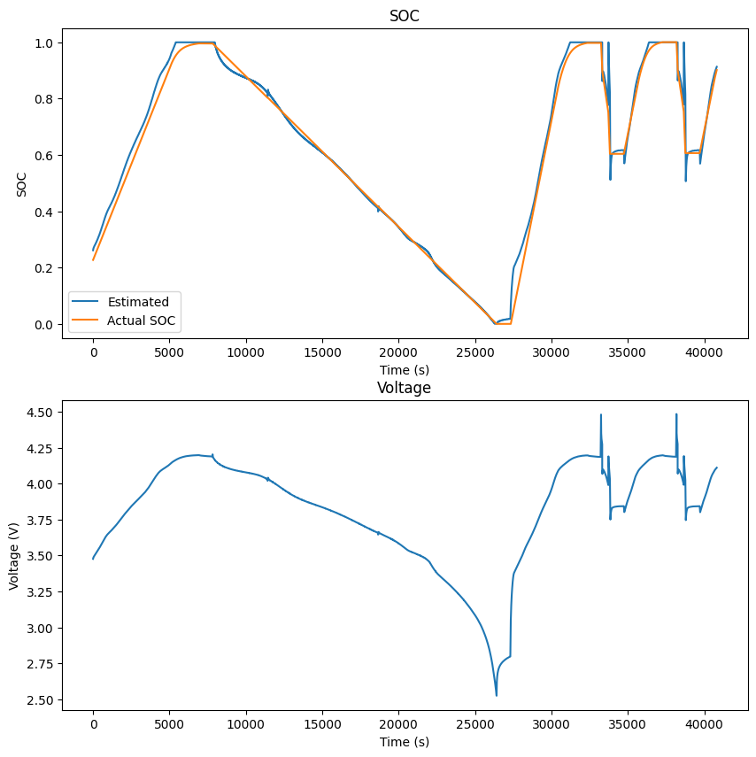
Why a Neural Network?
Complex models of batteries include features such as
Hysteresis
Capacitance
A Neural Network could pick up on such patterns and account for these spikes/noise of real world data and make more accurate predictions
Neural Networks can also learn overtime and self adjust to become more accurate

Slide 11
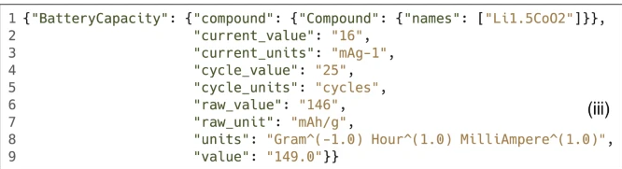
Training the AI
Take existing characterized batteries to create a cache of batteries
These batteries already have been characterized and have known k parameters
This cache makes this an AI characterization problem

Slide 12
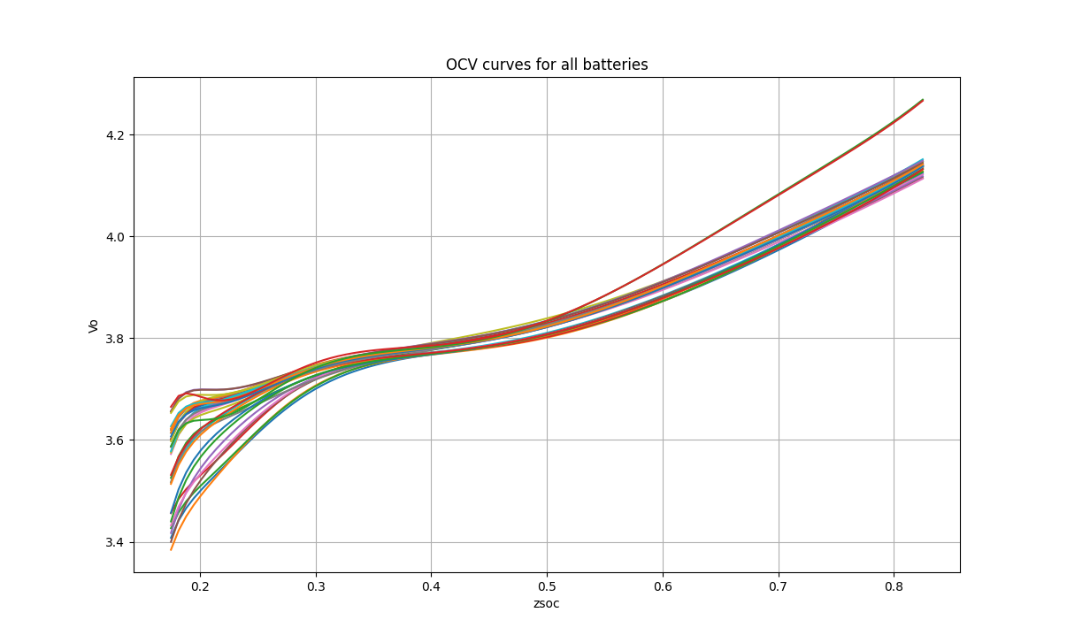
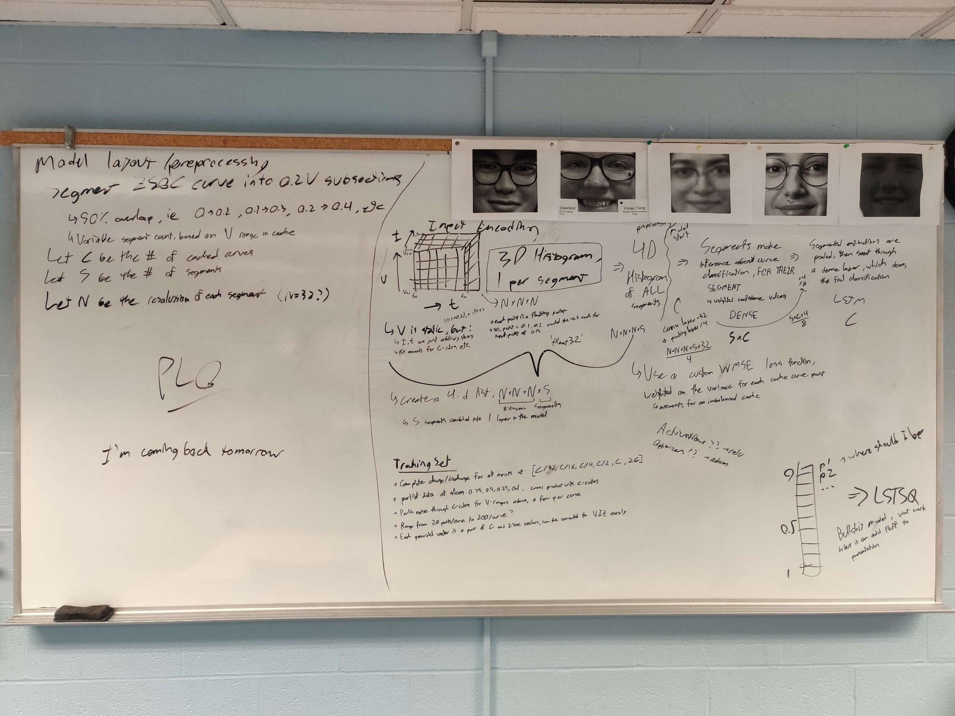
Dataset Curation
Using the cache of 34 known, characterized batteries and their associated K-parameters and R0 values, along with Dr. Bala’s BattSim function recreated in Python, a dataset was created.
Current profiles were generated to cover different C-rates and provide both full and partial data for all batteries in the cache.
Features for (a) Perlin Noise, and (b) simulation on a collected current vector, are marked as “future works”.
Notes:
Half the task of creating a specialized AI is the creation of the training set.

Slide 13
Preprocessing the Data
Problems
Solutions
Preprocessing of the data is problematic for input like this
Every input size needs to be the same in order for the model to work
How to encode three 1-D vectors in a way that a model can pick out features?
Encoding sample vectors into a histogram allows for same-dimension inputs
Because of the histogram, several samples can be overlaid into the same input, making for a more accurate estimation over time.

Slide 14
Preprocessing Theory
OCV curves can be split into sections, which allows us to predict on partial data
Partitioned data are split into “chunks” with a 50% overlap, each chunk is its own histogram
Histogram are normalized and centered, the voltage dimension is constant for that chunk, and the time and current vectors are scaled per sample or cell

Slide 15
CNN Theory
The histograms for each of the “Chunks” can be fed into the model directly.
The model convolutes, pools, and then goes through a dense layer.
This first dense layer behaves like a collection of dense layers, one for each chunk, where each chunk can produce its own estimation.
The output layer uses the estimations produced by the previous layer to make an estimation on which cached battery is the correct one.

Slide 16
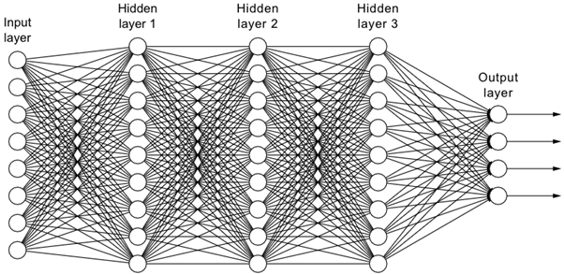
AI Models Evaluated
Convolutional Neural Network as a Characterization Problem
Convolutional Neural Network as an Extrapolation Problem
LSTM as a Categorical Problem
None of these worked very well, but it could be due to flaws in preprocessing or the dataset.
More models are on the backlog, SciKit- Learn, we have recently discovered it to perform better, but so far we have only tested Keras.

Slide 17
Implementation
Devices
Communication
API
Database
Cloud Computing

Slide 18
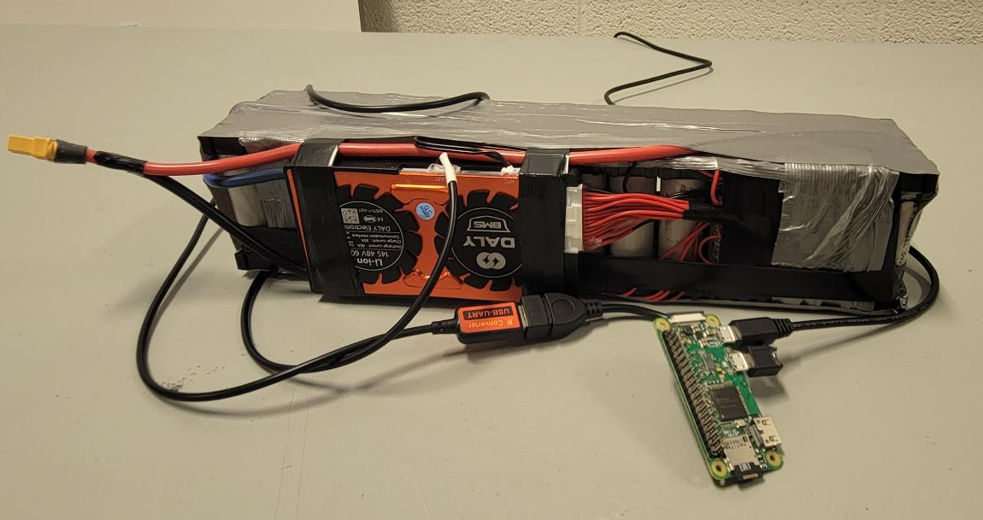
Device
Raspberry Pi
Connects to Daly Battery Management System
Every second collects information including:
Time
Voltage
Current Draw

Slide 19
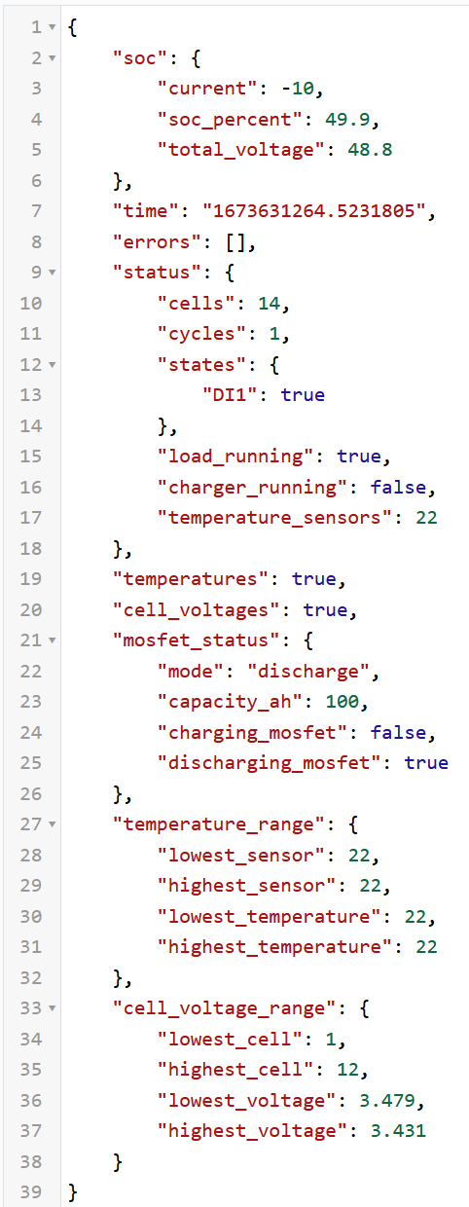
Communication
Serial
Raspberry Pi connects to Daly battery management system through UART
MQTT
Raspberry Pi sends the data to centralized server over (MQTT) MQ Telemetry Transport
This is a lightweight messaging protocol that is simple and low bandwidth dependent
Data is encoded in JSON format
Notes:
Explain Serial
MQTT

Slide 20

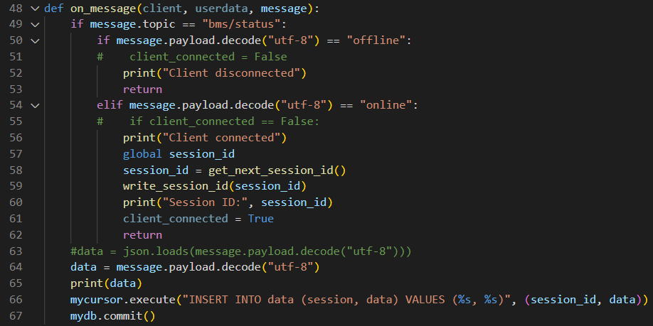
API
Python Script
Watches the MQTT server for new publishes
Decodes and uploads data to a MySQL Database
Notes:
Explain how the API watches the MQTT server and when one is online, it checks if serial number is already there and adds it, then starts writing data info every new publish of the connected device

Slide 21



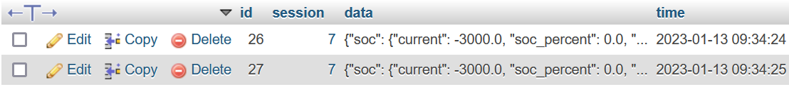
Database
MySQL
3 different tables total
Serial Number
Session ID
Data
Notes:
There are probably faster, better databases to use, but we chose MySQL due to familiarity and integration with myPHPadmin for easier and quicker deployment
Talk about the schema, how one relates to another
k-param shows amongst the cache batteries which is closest to

Slide 22
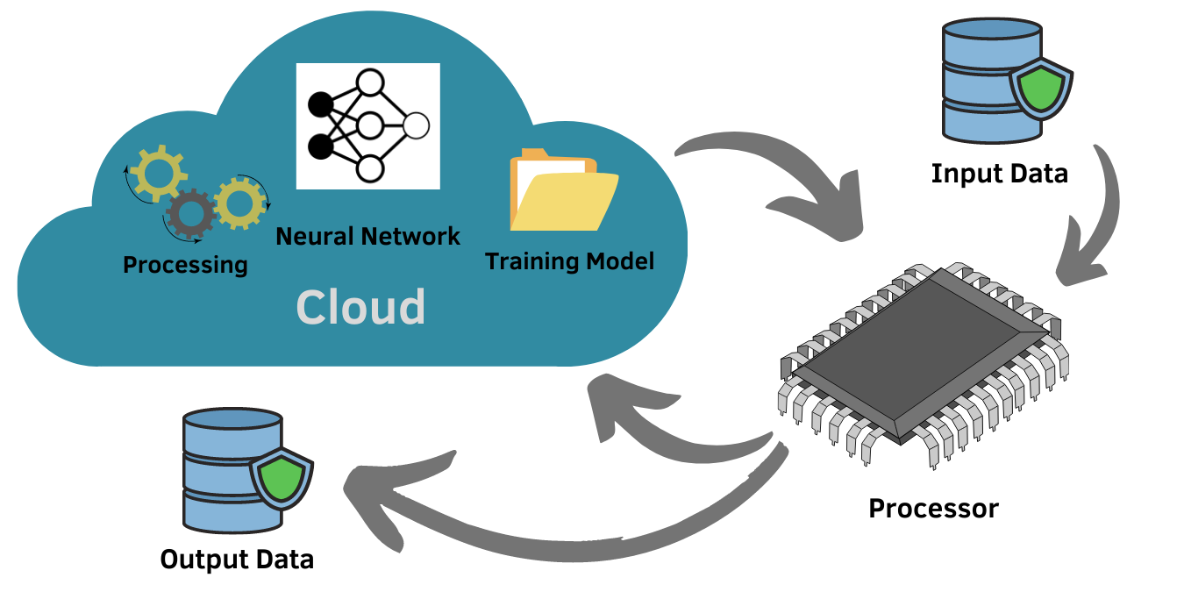
Cloud Computing with AI
Once the Neural Network determines there is enough information after the charge or discharge cycle session, it performs a prediction on which cache of battery the cell preformed closest to.

Slide 23
Thank You!
More information can be found at
https://github.com/colefuerth/AI-Characterization
https://github.com/colefuerth/CloudBFG
https://github.com/colefuerth/BattSim

